Slide 1


InForm Voice
Managed and Supported Terminals
Jan 29, 2026 – Rev 1.6

Slide 2
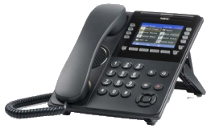
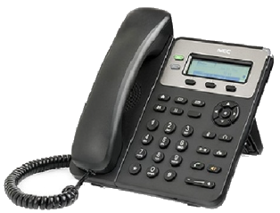
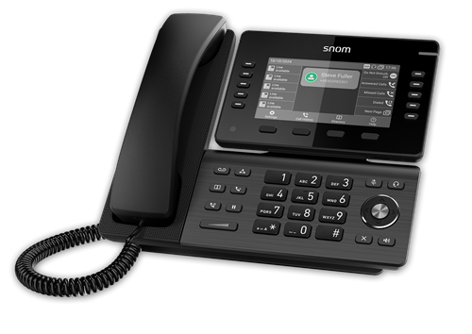
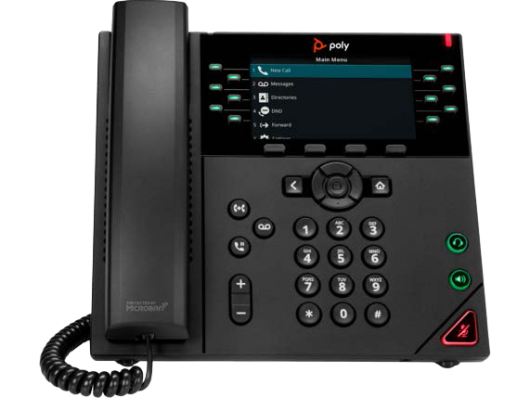
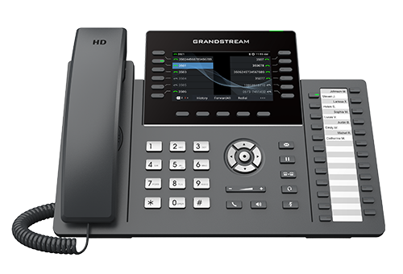




Managed Terminals
Managed means:
  InForm Voice (IFV) creates config files for the phones
  IFV manages firmware upgrades for the phones
  IFV can bulk import those phones
  For some phones IFV can manage their key programming
  Simplifies deployment and management of phones
DT700/820/900 GT120/890
8 models to date
VVX/Trio
GXP/GXV/GRV

Slide 3

Managed Terminals - Details
 | IFV-Managed Models | Managed Keys
 | All DT700 and DT820 models All DT900 and DT900S models (except the ITK-12/24CGs and the “-2” models) GT120 and DT890 | Yes Yes No
 | D150, D710, D713, D735, D810, D812, D815, D865 Comtel Voice branded: D150, D713, D812 | Yes
 | All Poly Trio (except C60, coming soon) All Poly VVX models | No
 | GRP2615, GRP2612 GXV3470 , GXV3480, GXV3370 GXP1630, GXP1782, GXP2170 | No*
IFV also manages Tone Commander’s Teo phones meant for the DoD.
* However, BLF works if configured manually

Slide 4
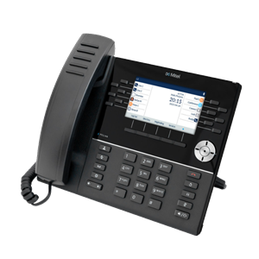
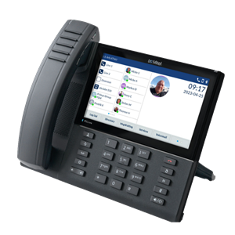

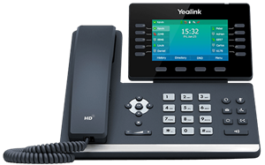

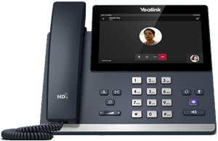
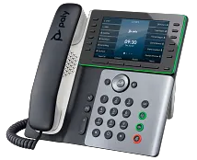
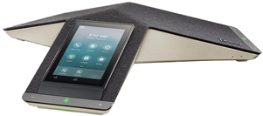
Managed Terminals - Future
 | Models we plan to manage | Managed Keys
 | 6900 Series phones Currently in Development! | Yes
 | Which models still to be determined. Will likely include T44w, T54w, MP56 E2 | TBD
 | Poly Edge E series Poly Trio C60 | TBD

Slide 5



Supported – Dev Tested Terminals
Supported – Dev Tested means:
  Development has tested the vendor’s phones (either all models or a specific models)
  Development evaluated 70+ SIP, integration, and related features
  All test results are documented in the IFV Compatibility Mega Matrix spreadsheet
DECT

Slide 6
Supported Dev-Tested Terminals - Details
 | Models Tested by IFV Development Team
 | 6905, 6910, 6930w / 6920w, 6940w
 | G266, G566, G966, I766, M166, G277, G577
 | T44s, T54w, T46s
 | ND2210
 | 3300IP, 9600IP/9600MWD
 | vIPer phone
DECT

Slide 7



Other working Terminals
General Support:
  Since IFV uses open SIP standards, these phones are expected to work for basic SIP functionality
  The phones listed below have been used successfully in an IFV lab environment and/or at customer sites

